Slide 1

Artificial Intelligence in Language Learning
Explore the transformative power of AI in language acquisition and practice, from defining AI to crafting effective prompts and utilizing innovative tools for language learning.
OM
by Olga Muñoz

Slide 2

Understanding Artificial Intelligence
"Artificial intelligence is not a substitute for human intelligence; it is a tool to amplify human creativity and ingenuity.“
Fei-Fei Li, Co-Director of the Stanford Institute for Human-Centered Artificial Intelligence

Slide 3

Understanding Artificial Intelligence
Definition
AI is defined as "the ability of a machine to display human-like capabilities such as reasoning, learning, planning and creativity“
https://www.iso.org/artificial-intelligence/what-is-ai
Capabilities
AI systems can perceive, process data, and act autonomously to achieve goals.
Application
AI amplifies human creativity and ingenuity across various fields.

Slide 4

AI Prompts Explained
What is an AI Prompt?
Input provided to AI systems, guiding them to generate relevant responses.
Forms of Prompts
Questions, commands, statements, or code samples used to interact with AI.
Purpose
Enables effective communication with AI for tailored, contextual responses.

Slide 5
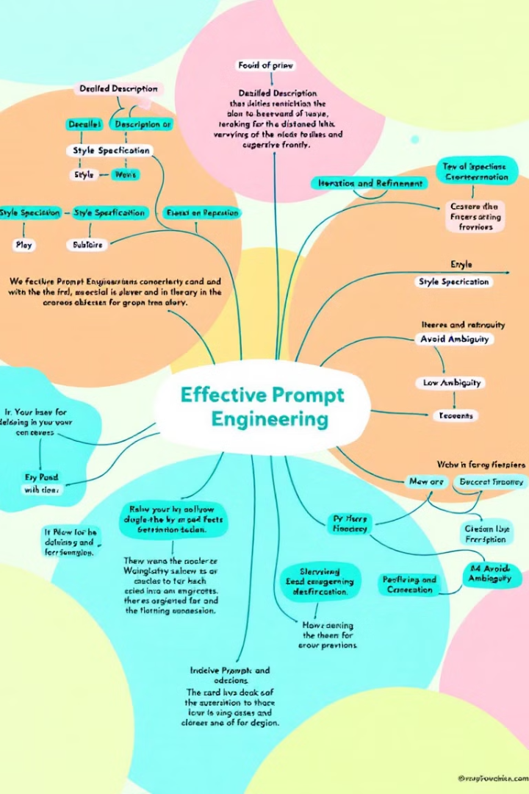




Crafting Effective AI Prompts
Define a Clear Objective
Specify exact requirements for the AI's task.
Use Natural Language
Communicate with AI as you would do it with a human.
Provide Context and details
Include relevant details for more accurate responses.
Structure your prompts Effectively
Organize prompts logically to guide the AI.

Slide 6


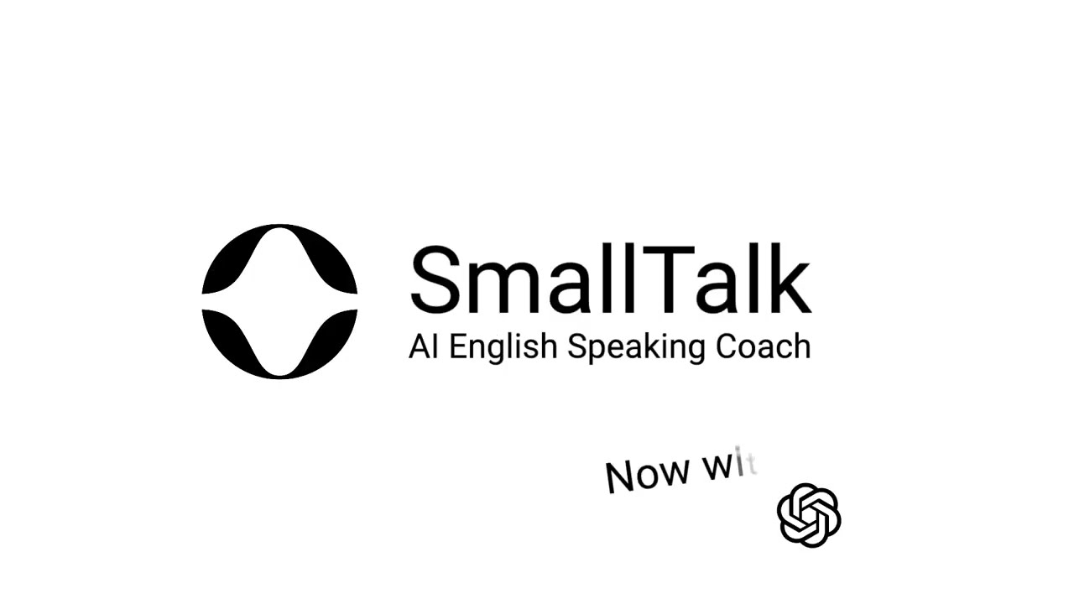



AI Tools for English Speaking Practice
SmallTalk2Me
These AI-powered tools offer interactive practice for improving English speaking skills.

Slide 7

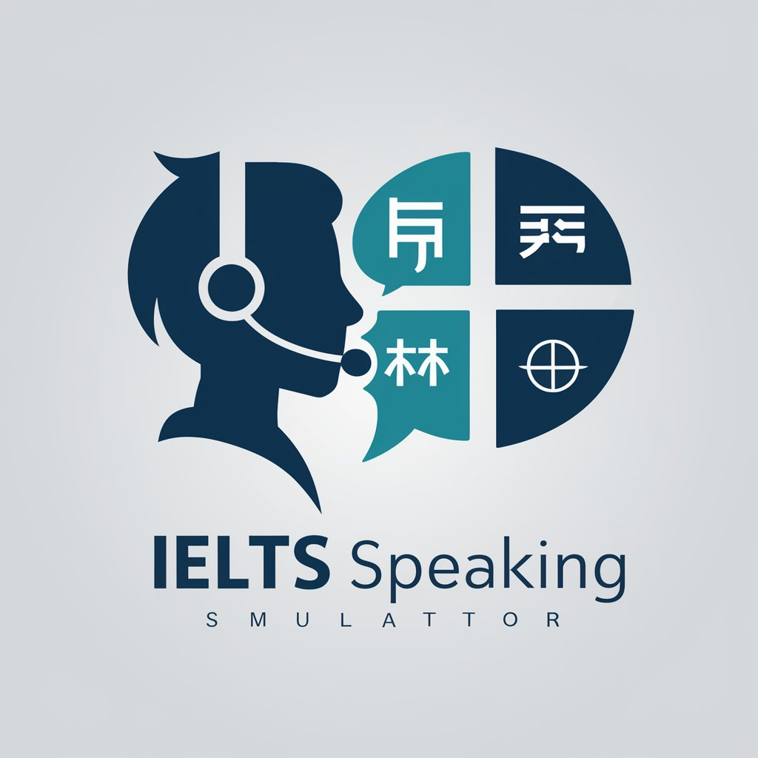
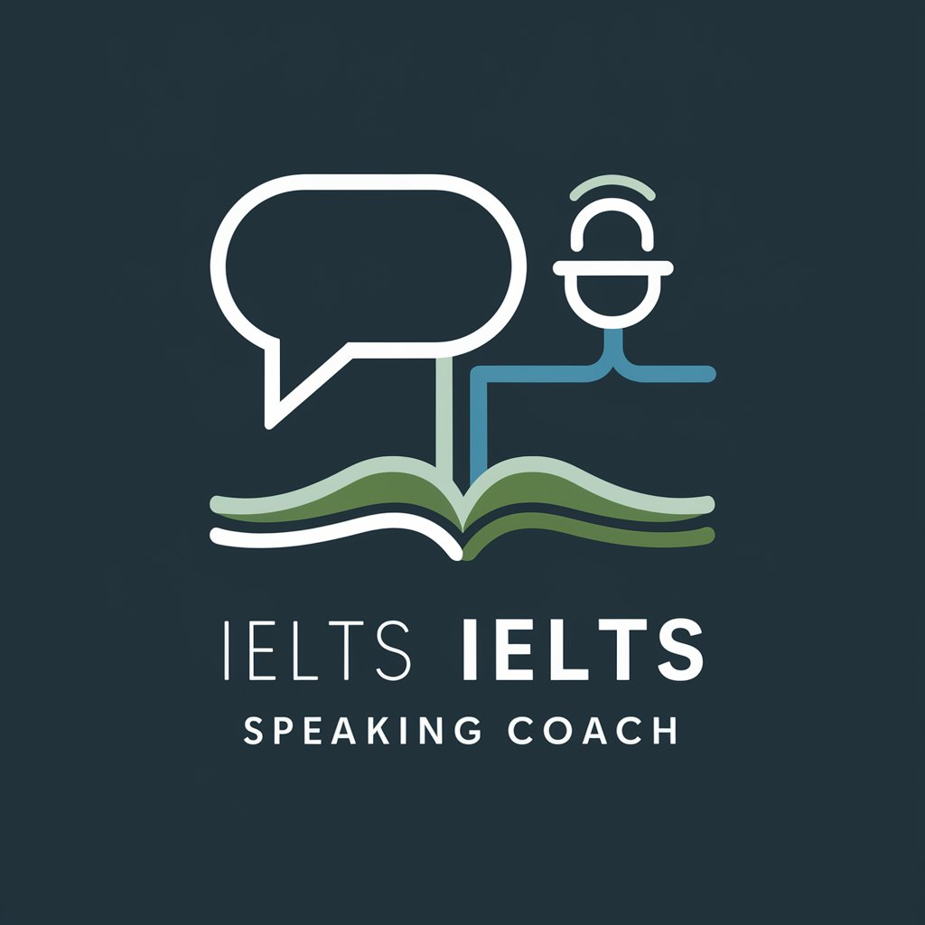


AI Tools for English Speaking Practice
Gabble.ai |
AI Powered Speaking Coach
Talkface-AI IETLS Speaking

Slide 8



AI Tools for Mock Speaking Exams for Cambridge English
AI Cambridge Coach from Weaver School
These AI-powered tools offer interactive practice for improving English speaking skills.

Slide 9




Creative Uses of Interactive Prompts
Role-Playing Scenarios
Simulate scenarios for practice and learning.
Dialogue
Create realistic conversations for various purposes.
Practice for the International Speaking Exams
It helps you improve and familiarise with the format of Internacional Speaking exam.

Slide 10

AI Tools for Enhancing Writing Skills
Yomu AI
Writefull Academizer
Assists with idea generation and overcoming writer's block.
Offers automated proofreading and language enhancement for academic writing.
Paperpal
ChatGPT
Provides language suggestions and checks adherence to academic conventions.
Offers versatile writing assistance and improvement suggestions.
Perplexity
IELTS Writing Checker
Assists with idea generation and overcoming writer's block.
Get your IELTS Writing Essays checked for FREE

Slide 11
AI Tools for Enhancing Writing Skills
Wordvice.ai
Jenni AI
offers a comprehensive suite of features including a paraphrasing tool, plagiarism checker, and real-time feedback.
provides autocomplete suggestions to help writers overcome blocks, along with paraphrasing capabilities and automatic citation generation
DeepL Write
QuillBot
focuses on refining writing by providing alternatives for words and sentences while ensuring correct grammar and punctuation.
offers features such as grammar checking, paraphrasing options, and citation generation

Slide 12
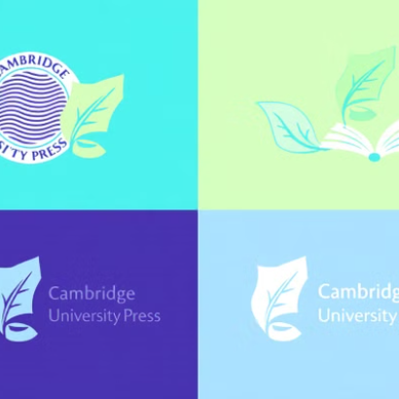
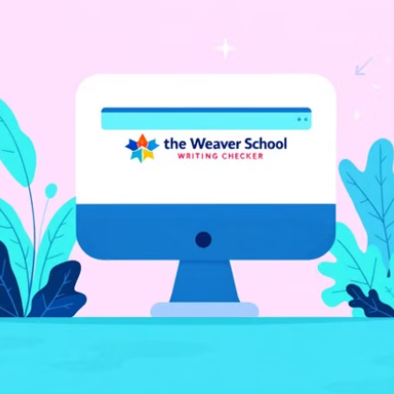
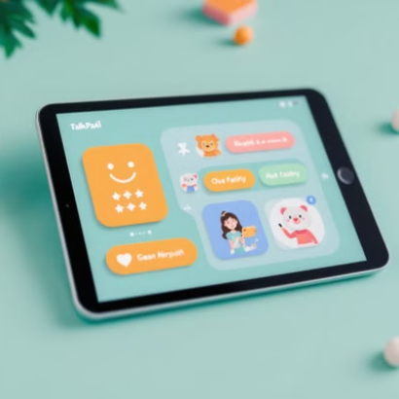
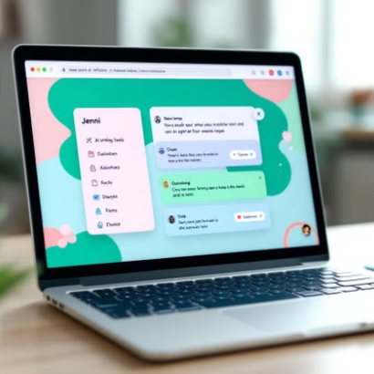
AI Tools for Cambridge Exam Writing Skills
Write & Improve
Writing Checker by Weaver School
TalkPalAI
Jenni AI
These AI-powered tools offer specialized assistance for Cambridge exam writing preparation.

Slide 13

AI Tools for Listening Skills
1
Language Learning Apps
Duolingo, Rosetta Stone, and Babbel offer AI-adapted listening exercises.
2
Speech Recognition Software
Google Speech-to-Text helps compare heard content with correct transcriptions.
3
Interactive AI Tutors
ALO7 and LingoKids provide engaging conversations with virtual characters.

Slide 14




AI for Reading Improvement
Use of English AI
Tailored exercises for advanced reading comprehension.
TalkPalAI
Interactive reading practice with AI-generated content.
Mock Test Creation with AI
AI-generated practice tests for targeted reading improvement.

Slide 15
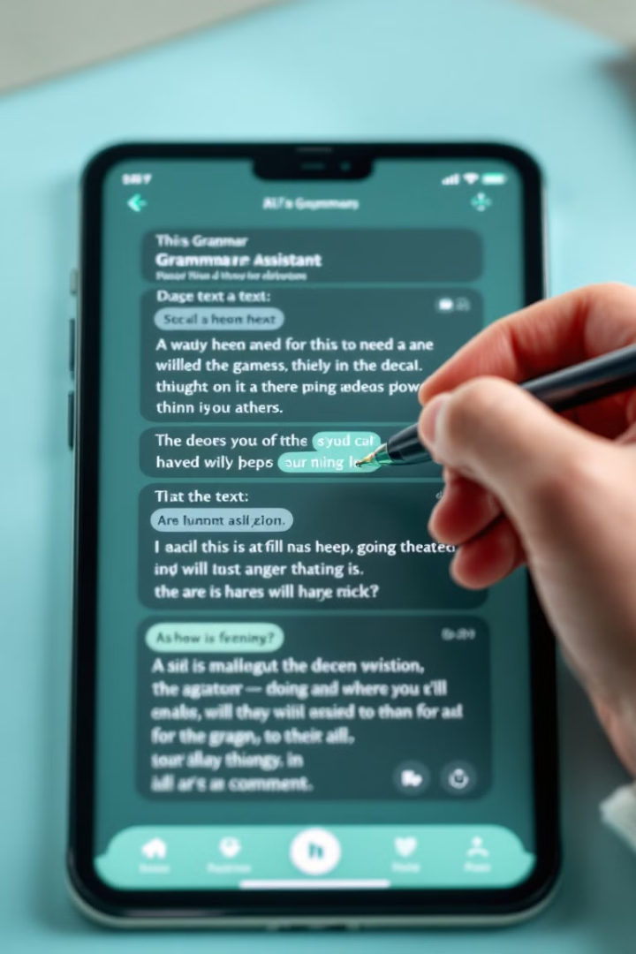
AI Grammar Tools
Grammarly
ProWritingAid
Real-time corrections and tone detection for comprehensive writing improvement.
Detailed reports on style, readability, and contextual grammar suggestions.
Wordtune
Offers rewriting suggestions and tone adjustments for enhanced clarity.

Slide 16




Online Vocabulary Tools
Cambridge English
Official CAE preparation resource with extensive vocabulary exercises.
GlobalExam
Comprehensive platform offering targeted CAE vocabulary practice.
Magoosh
Interactive vocabulary builder with spaced repetition technology.

Slide 17
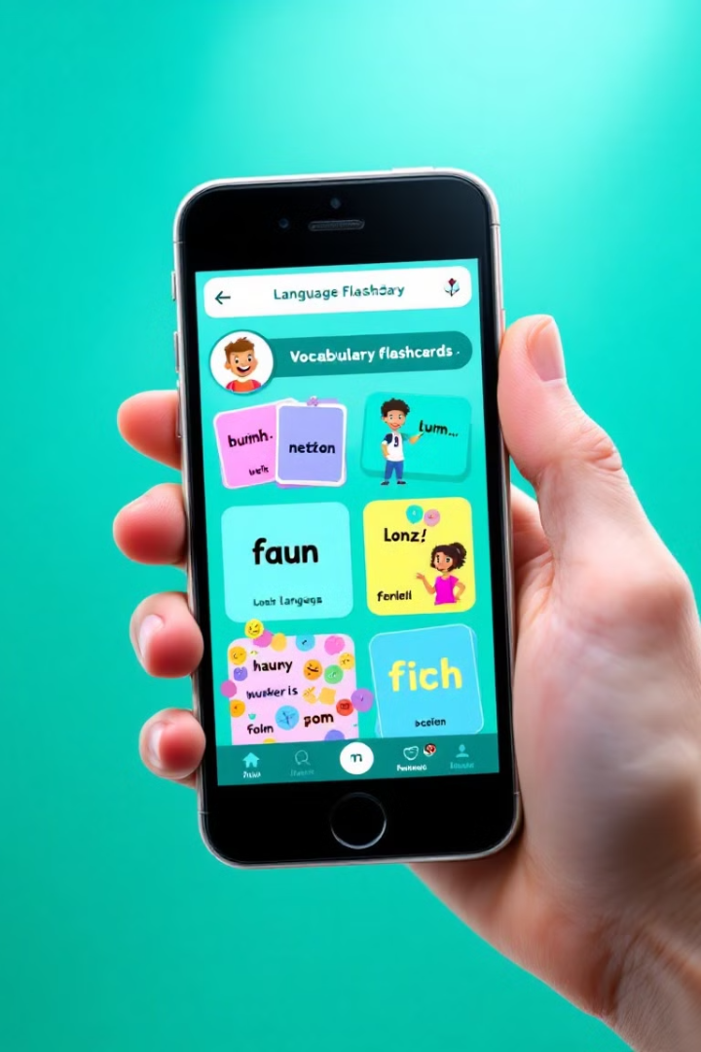
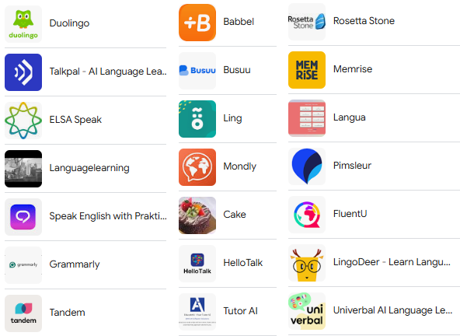

Mobile AI Apps For Learning English

Slide 18

AI Translation: DeepL
DeepL
offers advanced AI-powered translation, helping learners understand complex texts and improve their language skills. Visit https://www.deepl.com/es/translator for more information.
Directory of Artificial Intelligence Tools
aifindy.com

